Slide 1
Perspective on future of digital payments
PI 13 Mojaloop Community Event
Paul Makin

Slide 2
Where are we now?
Perspective on Future of Digital Payments

Slide 3
The Baseline: Cash
Why do we still have cash?
Interoperability
Often the fallback when others fail
Instant settlement
The recipient can use the cash received immediately
Offline, face to face use
Anonymous
There’s no KYC process
Accessible to everyone
No-one is excluded
You always know your balance
What’s wrong with cash?
Remote is difficult
Sending cash is expensive and risky
Making change
Slow, forces people to talk(!)
Cost
Cash is extremely expensive
Terrorism/Crime
Easily stolen
Anonymous
BUT large amounts are bulky and difficult to move!
COVID

Slide 4



What would an ideal alternative look like?
 | Interoperable
 | Instant
 | Face to face use | Including offline Make it contactless
 | Online, remote use
 | Anonymous | Once you remove all other friction, and can do remote transactions at will (no bulky cash), your privacy rights diminish
 | Low cost | For the economy and the individual Not dependent on the technology held by the individual
 | Secure
 | Available to the excluded

Slide 5
Interoperability
Interoperability is not a small, technical concept
It has a long pedigree
The origins of ‘Visa’ and ‘Mastercard’
But it’s often implemented badly, or not at all
Resulting in ‘Payment Islands’
This even affects Visa and Mastercard
Some examples: Nepal, early M-Pesa
Inter-scheme interoperability is then provided by….cash
Lack of interoperability across payments systems is a significant brake on any economy

Slide 6
How do current offerings measure up?
 | Payment Cards | Mobile Money | QR Codes | UPI et al
Interoperable
Instant
Face to face use
Online, remote use
Low cost
Secure
Available to the excluded

Slide 7
How did we get to this point?
Current offerings weren’t designed with the excluded in mind
Exclusion is a big problem in the developing world, but it’s commonplace in the industrialised world as well; this is a worldwide problem
We are designing payments systems with potential worldwide impact – so we should be thinking of the financially excluded everywhere, in all of their myriad circumstances

Slide 8
We can’t just focus on payments: Don’t forget authentication
Necessary – but who cares?
Entering a PIN is SO last millennium
Biometrics works, but is awkward (think COVID)
How do we make it disappear?
Think “ambient authentication”
But don’t forget authorisation
Only possible if we empower the customer
Account information
Cross-DFSP account information

Slide 9
Emerging Payment Technologies
Perspective on Future of Digital Payments

Slide 10
Digital Currencies
Definition: A currency that is not “backed” by a fiat currency held in a bank account
Some examples:
Mondex (1993)
Not truly a digital currency; backed by a fiat currency, but in a pooled account (like M-Pesa’s model), rather than individual accounts
Tied one to one with a fiat currency; the original “stablecoin”
Private (aka cryptocurrencies): Digicash (1990), Bitcoin (2009)

Slide 11
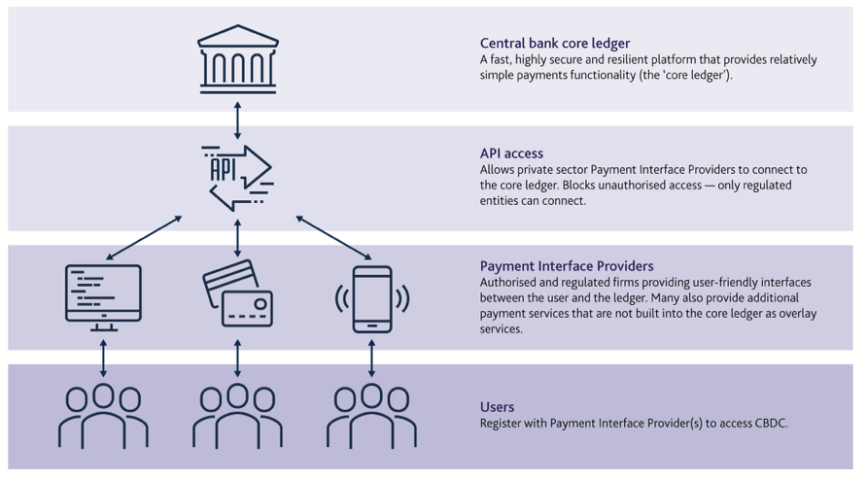
Central Bank Digital Currencies
A digital currency issued by a central bank, making it fiat
Might be wholesale or retail
Retail Implementations:
Canadian Mint (wallet-based)
Sweden’s e-Krona (blockchain-based)
Sweden’s approach highly influential

Slide 12
Identity-based payment
Why do we still stick with providing bank account details to payers?
Not “pay me” – instead, ”pay my bank account”
None of your business where I keep my money (also fraud)
Some have moved to “pay me” models: UPI (India), NIBSS (Nigeria)
Nigerian Government saw immediate benefits
These are first generation; second generation:
Different aliases for different purposes
Automatic routing
Put the customer in control

Slide 13
Instant transactions
“Instant” transfer of value from the payer to the payee
Helps grow financial confidence in the underserved
Supports budgeting
Effect on the retailer can be remarkable
Huge improvement in liquidity
Connections to wholesalers
B2B e-commerce
Consequent contribution to local economy

Slide 14
Free retail transactions
If you charge, you power the flight to cash
Merchants won’t pay; neither will customers
Free up to a fixed volume (US$100/week, say)
Beyond that a small percentage fee
Support small retailers with a business management app
ANYTHING to stop creating an incentive to stay with cash

Slide 15
Beyond Payments: Richer Financial Services
Get the financial sector to work in a coordinated manner:
Mandates are much maligned: but by working cross-sectorally, we could make them work FOR the underserved
This has the potential to reduce costs for the poorest in society
Many countries are seeing cultural changes that mean pensions need to reach towards the BoP
Pensions need to be re-designed to achieve this, and pensions providers need to work with insurers to make sure that short term family emergencies don’t wipe out a pension
In the long term this could contribute to the investment that every country needs

Slide 16
What’s the relevance for Mojaloop?
Perspective on Future of Digital Payments

Slide 17
The Mojaloop context: Instant transactions and Interoperability
Not directly connected to the customer’s payments
BUT Mojaloop supports instant transactions
Important: but not as important as Mojaloop’s contribution to interoperability
Not only does Mojaloop switch money, it also switches business models
Interconnecting MFIs and banks is important
But infinitely more important is connecting each MFI’s customers into the core financial system of a country
This is financial inclusion; this is why interoperability matters

Slide 18
Mojaloop’s position in the future of payments
 | Mojaloop
Interoperable |  | The heartbeat of Mojaloop
Instant |  | Built in
Face to face use |  | Depends on the FSPs that connect
Online, remote use |  | Depends on the FSPs that connect
Low cost
Secure
Available to the excluded |  | If the connected FSPs include those that focus on financial inclusion

Slide 19
Mojaloop retail payments
Mojaloop can support all of the “front end” technologies
You can see demos of cards, mobile wallets, QR code, etc.
Mojaloop’s ALS directly supports identity-based payments
Multiple aliases per person
Mojaloop and CBDCs is more nuanced
Potentially hugely significant for financial inclusion
Can support a number of implementation options
Very interesting to see how this develops

Slide 20
Thank you
Perspective on Future of Digital Payments

